Slide 1
Numpy
&
pandas

Slide 2

What is numpy?
Numpy stands for Numerical Python, is a powerful library in Python used for numerical computing. It provides support for large, multi-dimensional arrays and matrices, along with a collection of mathematical functions to operate on these arrays efficiently.
why are we using it?
Efficient Array Operations: NumPy allows for efficient manipulation of large arrays
Mathematical Functions: It provides a wide range of mathematical functions so complex mathematical operations to be performed easily.
Integration with Other Libraries: NumPy is the foundation for many other libraries such as Pandas, SciPy, and scikit-learn, making it essential for data analysis and machine learning tasks.
Memory Efficiency: NumPy arrays are more memory-efficient than Python lists

Slide 3

Operations that we can perform on data using numpy:
1. Array Creation
2. Array Manipulation
3. Indexing and Slicing
4. Mathematical Operations
5. Statistical Operations
6. Linear Algebra Operations
7. Logical Operations
8. Sorting and Searching
9. Broadcasting
10. Masking and Filtering
11. File Input and Output
12.Much More

Slide 4
Numpy arrays
Homogeneous Data: NumPy arrays store data of the same type, while Python lists can contain different data types.
Efficiency: NumPy arrays are more memory-efficient and faster due to their fixed type and contiguous memory layout.
Vectorized Operations: NumPy arrays support vectorized operations, making computations faster and more concise compared to iterating over lists.
Mathematical Functions: NumPy provides a wide range of mathematical functions optimized for array operations, enhancing performance.

Slide 5
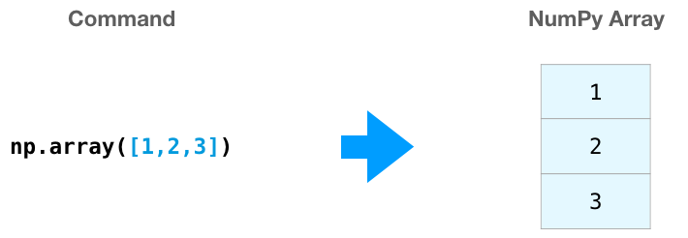
Creating arrays using Numpy
There are many other ways to create an array but we mainly use np.array() to create one
[[[[1. 1.]
[1. 1.]]
[[1. 1.]
[1. 1.]]]]
[[0. 0. 0. 0.]
[0. 0. 0. 0.]
[0. 0. 0. 0.]]
np.zeros((3, 4))
np.ones((2, 2, 2))
3D-array

Slide 6
Creating arrays using Numpy
np.arange(1, 10, 2)
[1 3 5 7 9]
np.linspace(0, 10, 5)
[ 0. 2.5 5. 7.5 10. ]
[[0.47217777, 0.11252467],
[0.7165194 , 0.5612339 ]]
np.random.rand(2, 2)
[[1 0 0 0]
[0 2 0 0]
[0 0 3 0]
[0 0 0 4]]
[[1. 0. 0.]
[0. 1. 0.]
[0. 0. 1.]]
np.eye(3)
np.diag([1, 2, 3, 4])

Slide 7

Array Manipulations using numpy
Reshaping
arr_1d = np.arange(8)
[0 1 2 3 4 5 6 7]
1D Array
arr_1d.reshape(4, 2)
arr_1d.reshape(2, 2, 2)
[[0 1]
[2 3]
[4 5]
[6 7]]
[[[0 1]
[2 3]]
[[4 5]
[6 7]]]
2D Array
3D Array

Slide 8
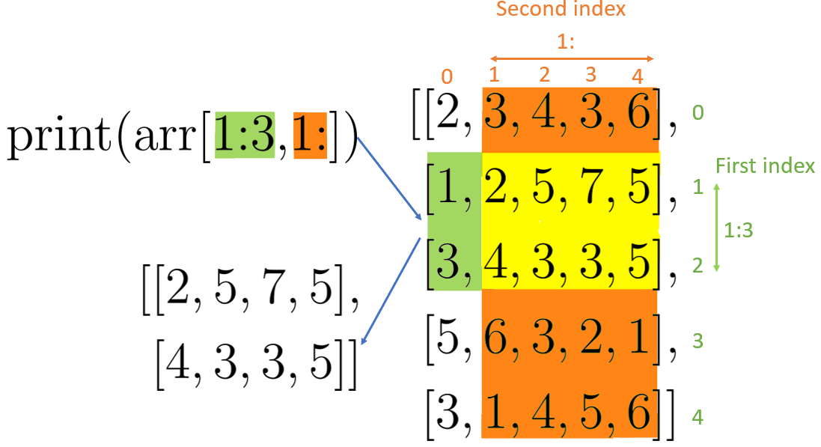
Array Manipulations :
Slicing an array

Slide 9

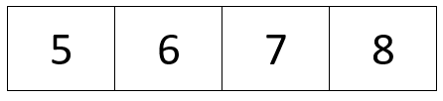
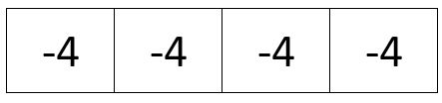
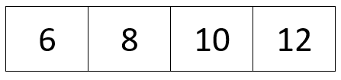
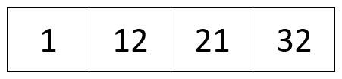
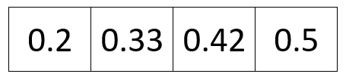
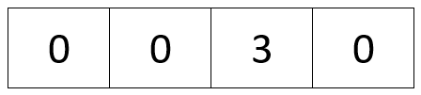
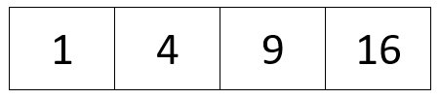
Mathematical operations:
For example lets take 2 numpy arrays
Array1
Array2
np.subtract(arr1, arr2)
np.add(arr1, arr2)
np.multiply(arr1, arr2)
np.divide(arr2, arr1)
np.remainder(arr2, arr1)
np.square(arr1)

Slide 10
Statistical operations:
np.sum(arr1)
10
Array1
np.mean(arr2)
6.5
np.std(arr1)
1.1180
np.var(arr2)
1.25
np.min(arr1)
1
np.max(arr2)
8
Array2

Slide 11
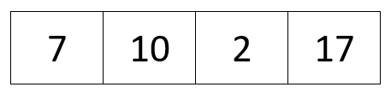

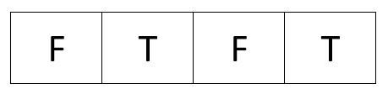
Masking:
Masking is a powerful feature in NumPy that enables you to handle missing or invalid data in numerical computations. It ensures that operations are performed correctly and avoids errors by treating masked values like NaN (Not a Number). This is particularly useful when working with large datasets where missing or invalid data is common.
There are many types of masks and can be initialized in many ways like using .
np.where(Condition ) to have a boolean mask and
similarly we use np.ma for masked_where(),masked_invalid ,etc methods
and also we can use pandas to create masks by using mask() method .
For example take a 1D array of 4 elements and we create a mask using np.where to get the values > 8.
np.where(arr > 8, True, False)

Slide 12
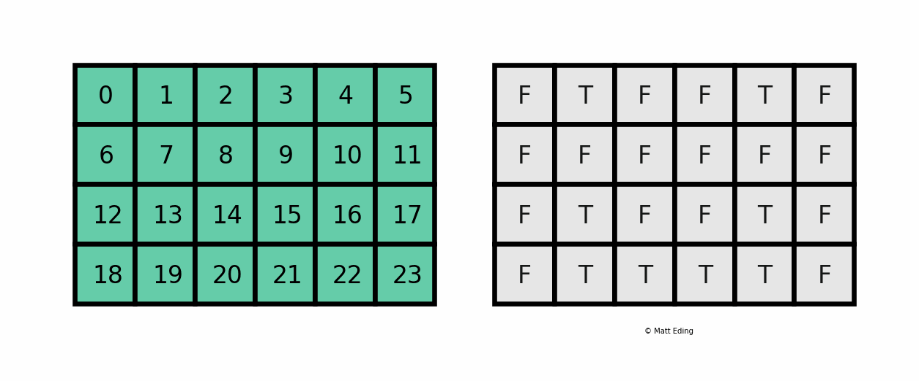
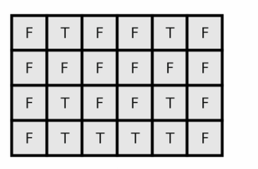
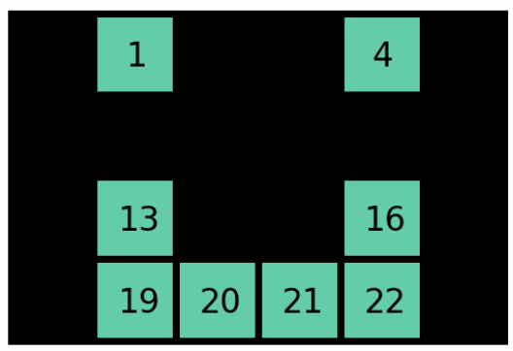
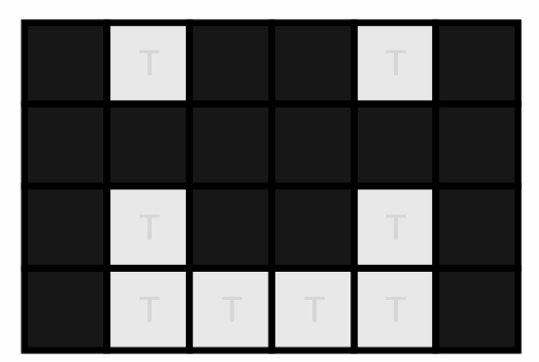
Masking:
original array
Boolean mask with condition
extracted masked array
identifying only true values

Slide 13
What is Pandas?
Pandas is a powerful open-source Python library for data manipulation and analysis. It provides easy-to-use data structures and data analysis tools for working with structured (tabular, multidimensional, potentially heterogeneous) and time series data. The name "Pandas" is derived from the term "panel data", an econometrics term for multidimensional data.
Why Use Pandas?
Data Manipulation: Efficient data structures for complex data manipulation tasks.
Data Analysis: Functions for data cleaning, filtering, sorting, grouping, and aggregating data.
Data Visualization: Integration with Matplotlib and Seaborn for easy visualizations.
Time Series Analysis: Built-in support for date range generation, time zone conversion, and resampling.
Missing Data Handling: Efficient methods for identifying, replacing, and interpolating missing values.
Performance: Built on top of NumPy for efficient numerical computing.

Slide 14

7. Concatenation
8. Merging
9. Head and Tail
10. Data Frame Creation
11. Date Range Generation
12. Time Zone Conversion,etc
Operations that we can perform on data using Pandas:
1. Row and Column Selection
2. Filtering
3. Handling Missing Data
4. String Operations
5. Data Descriptions
6. Plotting

Slide 15
Creating dataframes
A dataframe can be created by directly importind data from external sheets or we can create our own dataframe also like this :
Example:
data = {'Name': ['John', 'Anna', 'Peter', 'Linda'],
'Age': [28, 24, 35, 32],
'Country': ['USA', 'UK', 'Australia', 'Germany']}
df = pd.DataFrame(data)
loading a dataset:
pd.read_csv('data.csv')
pd.read_html('http://www.example.com')[0]
pd.read_excel('data.xlsx')
pd.read_sql('SELECT * FROM table', engine)
pd.read_json('data.json')

Slide 16
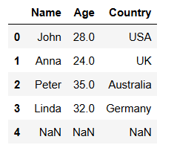
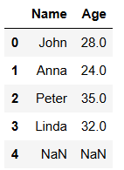


Preprocessing the data:
Dropping rows and columns:
Dropping rows and columns in a Pandas DataFrame helps in data cleaning and preprocessing by removing irrelevant or redundant data.
df.drop('Country', axis=1)
df.drop(df[df['Age'] > 30].index)

Slide 17
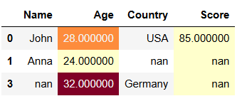
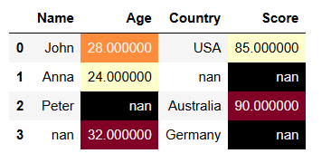
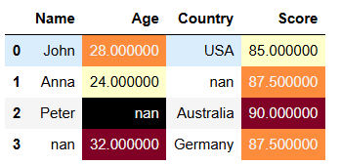
Removing or filling null values
dropping entire rows having null values
df.dropna(subset=['Age'])
filling null values with statistical values
df['Score'].fillna(mean_score)

Slide 18
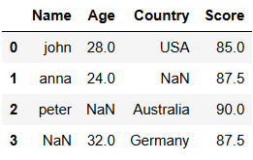
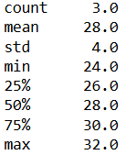
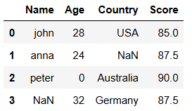
String operations:
Value counts:
USA 1
Australia 1
Germany 1
df['Name'].str.lower()
df['Country'].value_counts()
Data Descriptions:
Changing datatypes:
df['Age'].describe()
df['Age'].astype(int)

Slide 19
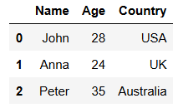
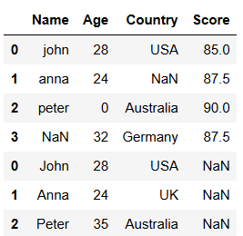
Concatenation:
pd.concat([df, new_df])

Slide 20
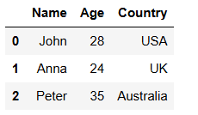
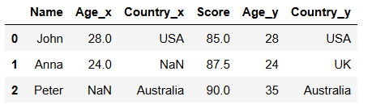
Merging:
pd.merge(df, new_df, on='Name')

Slide 21
What do we do using Numpy and pandas
Here we take a huge datasets to perform data analysis on them . Ex: we take huge dataset of IMDB i.e imdb.csv
This dataset is available in kaggle datasets.
Dataset contains the movies ratings, reviews ,cast directors and every info for movies released from 1929 to the present.
So by taking this datset we use numpy and pandas to perform data analysis .
Every data analysis is done to get some useful info from the data .
so we preprocess the data and then find best movies from the data .
with this preprocessed data we can get useful info like best categorized movies, to make predictions based on ratings and the movie categories etc.

Slide 22
Thank you

